Slide 1
Comparative Analysis of Apple Stock Price Prediction Methods
By Vivek Haridas

Slide 2
Problem
Motivation
There are a large number of forecasting methods that can be used to predict the price of stocks.
Idea : To compare and identify the best method given the dataset in both daily and weekly intervals.
The motivation behind this project is to predict the stock prices using machine learning in order to make more informed and accurate investment decisions to ultimately gain significant profits.

Slide 3
LITERATURE REVIEW
Stock Price Prediction Based on LSTM Deep Learning Model
Stock Market Prediction Based on SF-GAN Network
Time series forecasting using improved ARIMA
This study asserts that historical value takes into account all other market events which can be used to forecast future movement. Machine Learning techniques can identify methodologies and perspectives that can be used to make surprisingly accurate predictions.
The LSTM model is chosen to analyse and forecast stock market prices in order to make more informed and precise financial decisions. The proposed method utilizes a close price from S&P 500 component shares, to estimate the future close price.
Proposes an approach that uses GAN’s to predict prices of temporal data. The specific architecture used in this paper is called SF-GAN. It uses SFM as the generator and a CNN as the discriminator.
The SFM is a State Frequency Memory Neural that can dynamically learn state frequencies.
The proposed architecture performs better than state of the art models such as LSTM based on their MAE score.
This paper categorises previous famous works that explored the forecasting of time series data in various application areas, and then proposes a novel approach to improving the ARIMA model for time series forecasting by using a mean of estimation error.
Experimental findings show that the suggested technique can increase performance in the time series data forecasting process
The modified ARlMA model
is superior than the basic ARlMA model.
Along with this, we referred
papers of other models as well and incorporated them with the project

Slide 4
DATASET AND EVALUATION METRICS
Stock Dataset
Twitter Data
Evaluation
Dataset : Apple Inc. Common Stock (AAPL) taken from the Yahoo Finance API.
Types of Data :-
Daily Data
Weekly Data
Time frame : 1st January 2014 to 1st April 2022.
Scraped for data using Tweepy API.
Time Frame : January 2016 to August 2019
On the scraped tweets, sentiment analysis was performed to obtain the polarity of the tweets.
This polarity was then used as a feature while building the model.
Common predictive accuracy measures :
Mean Absolute Error
Root Mean Squared Error
Mean Absolute Percentage Error.
Plotting graphs for each model showing the training data, test data and predicted stock data.

Slide 5

METHODS IMPLEMENTED
XGBoost with Sentiment Analysis
ARIMA
LSTM
Dataset from Yahoo API
and
Scraped Twitter Data
GAN
GRU
SMA-10
SMA-20
BiLSTM
EWMA-3
EWMA-12
EWMA-6

Slide 6
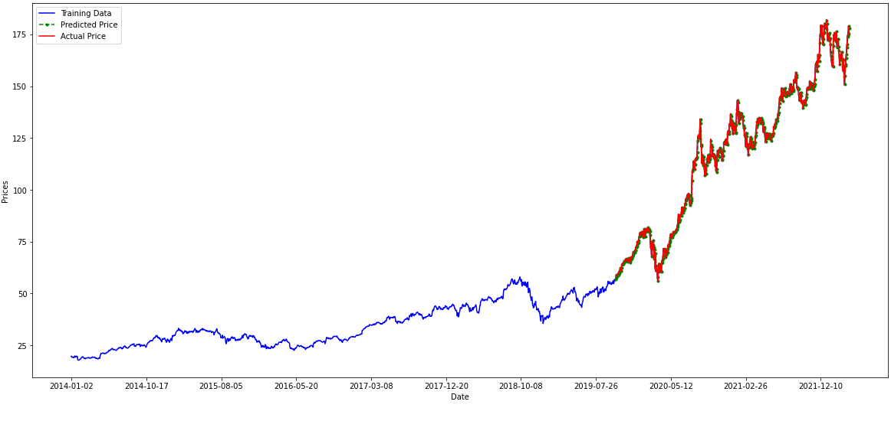
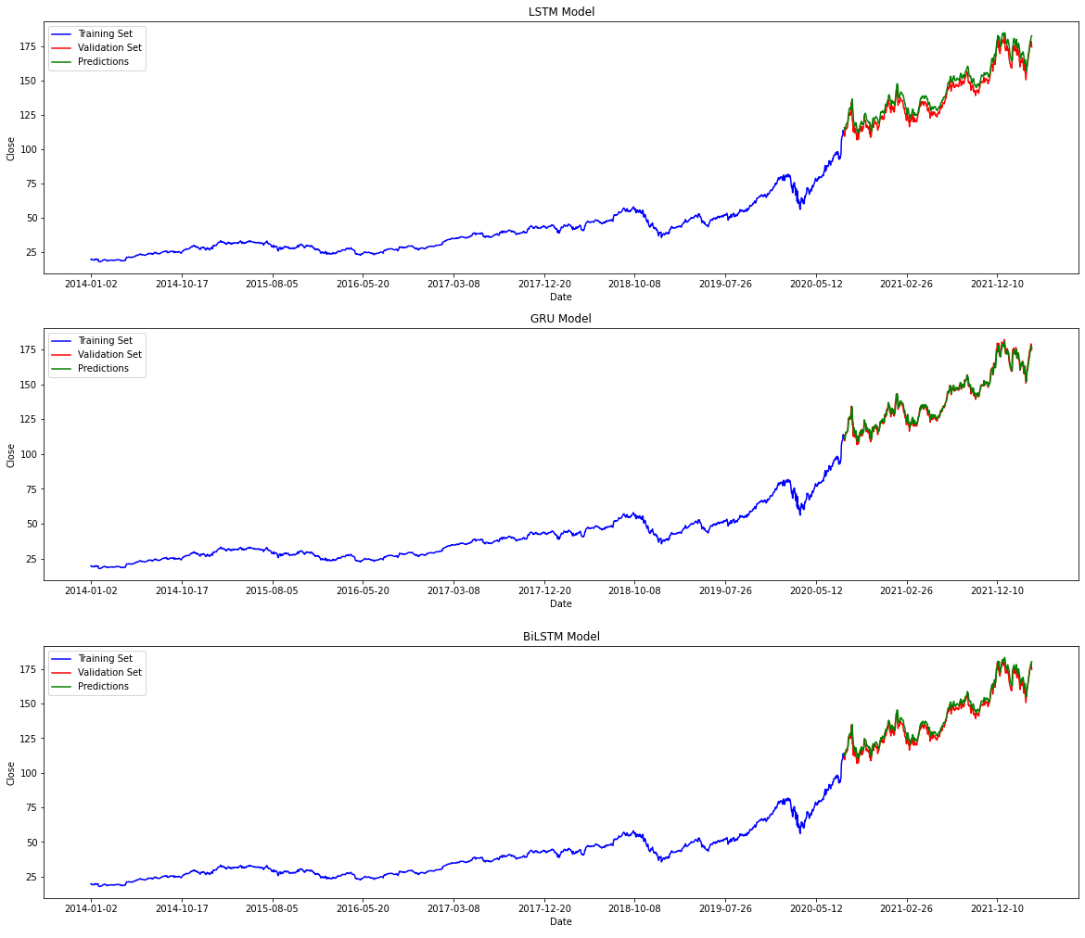
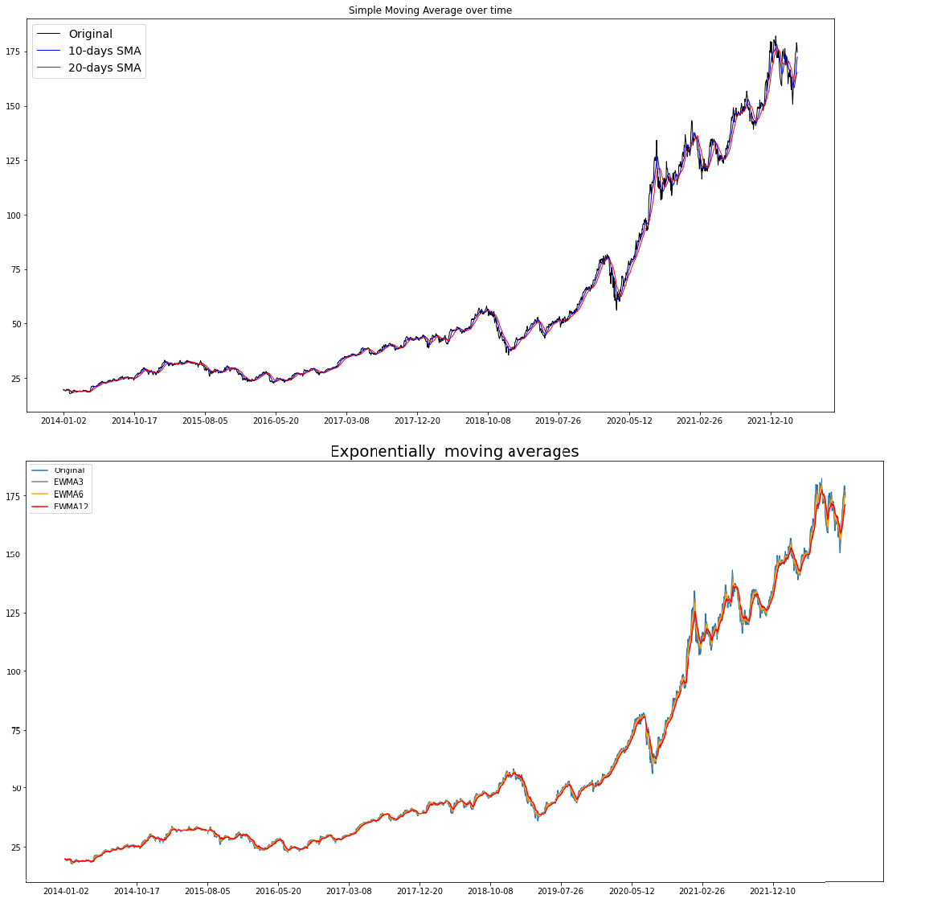
EXPERIMENTAL RESULTS ON DAILY DATA
MA
ARIMA
RNN Models

Slide 7
ACCURACY MEASURE VALUES (DAILY DATA)
 | MAE | RMSE | MPE | MAPE
ARIMA | 1.76 | 2.43 | -0.17 % | 1.55 %
SMA-20 | 2.12 | 3.33 | 0.85 % | 3.35 %
EMA-12 | 1.33 | 2.14 | 0.49 % | 2.10 %
LSTM | 4.43 | 5.08 | 3.09 % | 3.22 %
GRU | 2.02 | 2.65 | 0.38 % | 1.47 %
BiLSTM | 2.98 | 3.63 | 1.82 % | 2.17 %
GAN | 1.29 | 1.84 | 0.03 % | 2.28 %
XGBoost | 0.26 | 0.33 | 0.42 % | 0.77 %
Measure
Model

Slide 8
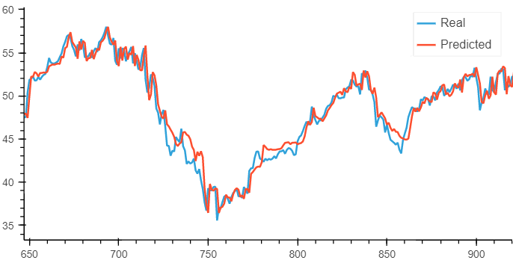
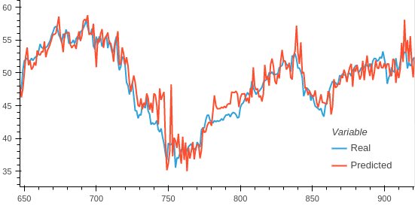
EXPERIMENTAL RESULTS ON TWITTER DATA
XGBoost with Tweet Polarity as Feature
XGBoost with Tweet Polarity as Feature
 | MAE | RMSE | MPE | MAPE
XGBoost (with Tweet) | 0.26 | 0.33 | 0.42 % | 0.77 %
XGBoost (without Tweet) | 0.36 | 0.43 | 0.51 % | 0.83 %
Measure
Model

Slide 9
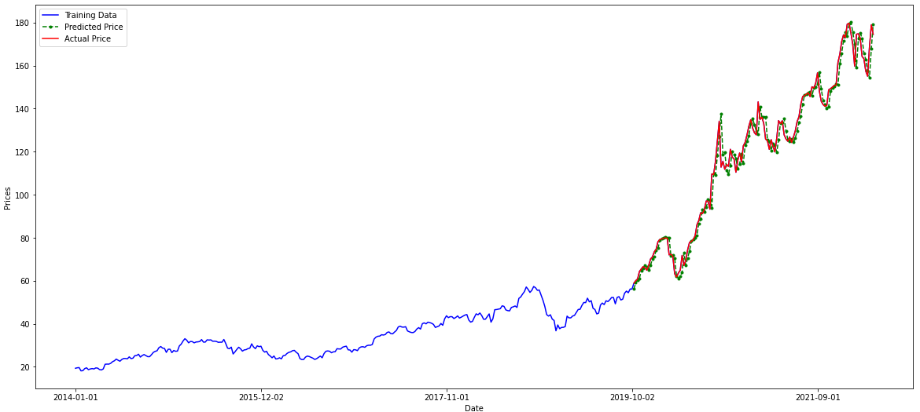
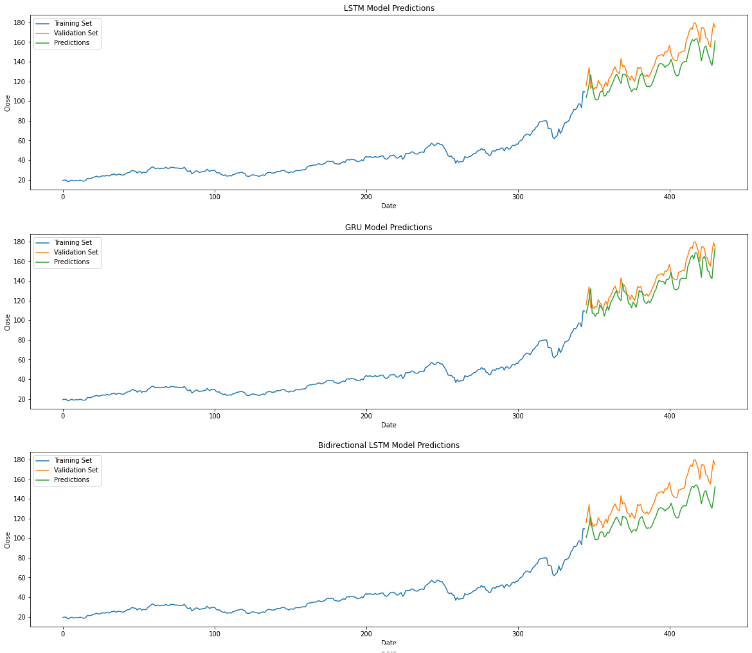
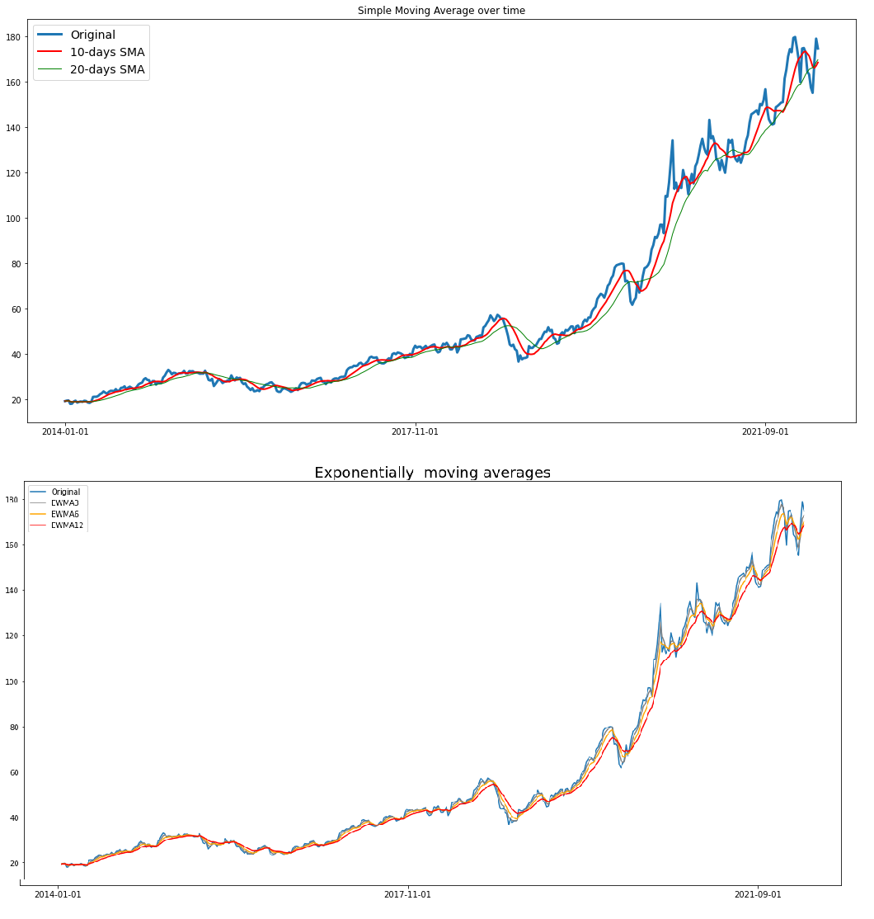
EXPERIMENTAL RESULTS ON WEEKLY DATA
MA
ARIMA
RNN Models

Slide 10
ACCURACY MEASURE VALUES (WEEKLY DATA)
 | MAE | RMSE | MPE | MAPE
ARIMA | 3.82 | 5.41 | -0.54 % | 3.25 %
SMA-20 | 4.80 | 7.38 | 4.06 % | 7.62
EMA-12 | 3.15 | 4.78 | 2.34 % | 4.95 %
LSTM | 12.45 | 14.04 | -8.38 % | 8.68 %
GRU | 8.90 | 10.44 | -5.79 % | 6.27 %
BiLSTM | 18.07 | 19.37 | -12.41 % | 12.59 %
GAN | 1.44 | 2.09 | 4.64 % | 7.51 %
Measure
Model

Slide 11
References
Kavinnilaa J, Hemalatha E, Minu Susan Jacob, Dhanalakshmi R, “Stock Price Prediction Based on LSTM Deep Learning Model”, 30 July 2021. https://ieeexplore.ieee.org/document/9526491
Soheila Mehrmolaei, Mohammad Reza Keyvanpour, “Time series forecasting using improved ARIMA”, 9 April 2016. https://ieeexplore.ieee.org/document/7529496
Jie Jiang, “Stock Market Prediction Based on SF-GAN Network”, 11 January 2021. https://ieeexplore.ieee.org/document/9644459

